Slide 1
AI-Driven Infrastructure Capacity Planning Advisor
Linu Simon · Bishoy E · Sebin J · Anooj A S · Refeena T P

Slide 2




Problem & Solution
THE CHALLENGE
OUR SOLUTION
Manual Planning Errors
Low Workload Visibility
AI Forecasting
Live Visualization
Web tool with capacity forecasts and risk scoring
Over-provisioning and shortages from manual capacity planning
Limited insight into usage trends and demand changes
Real-time charts and scenario modeling
Multi-Agent Optimization
Clear Targets
No AI Guidance
Business Impact
80% forecast accuracy · 20% cost savings · API integration
Actionable recommendations from AI agents
Tools provide metrics, but not actionable recommendations
Reliability risks, budget waste, and scaling limits

Slide 3
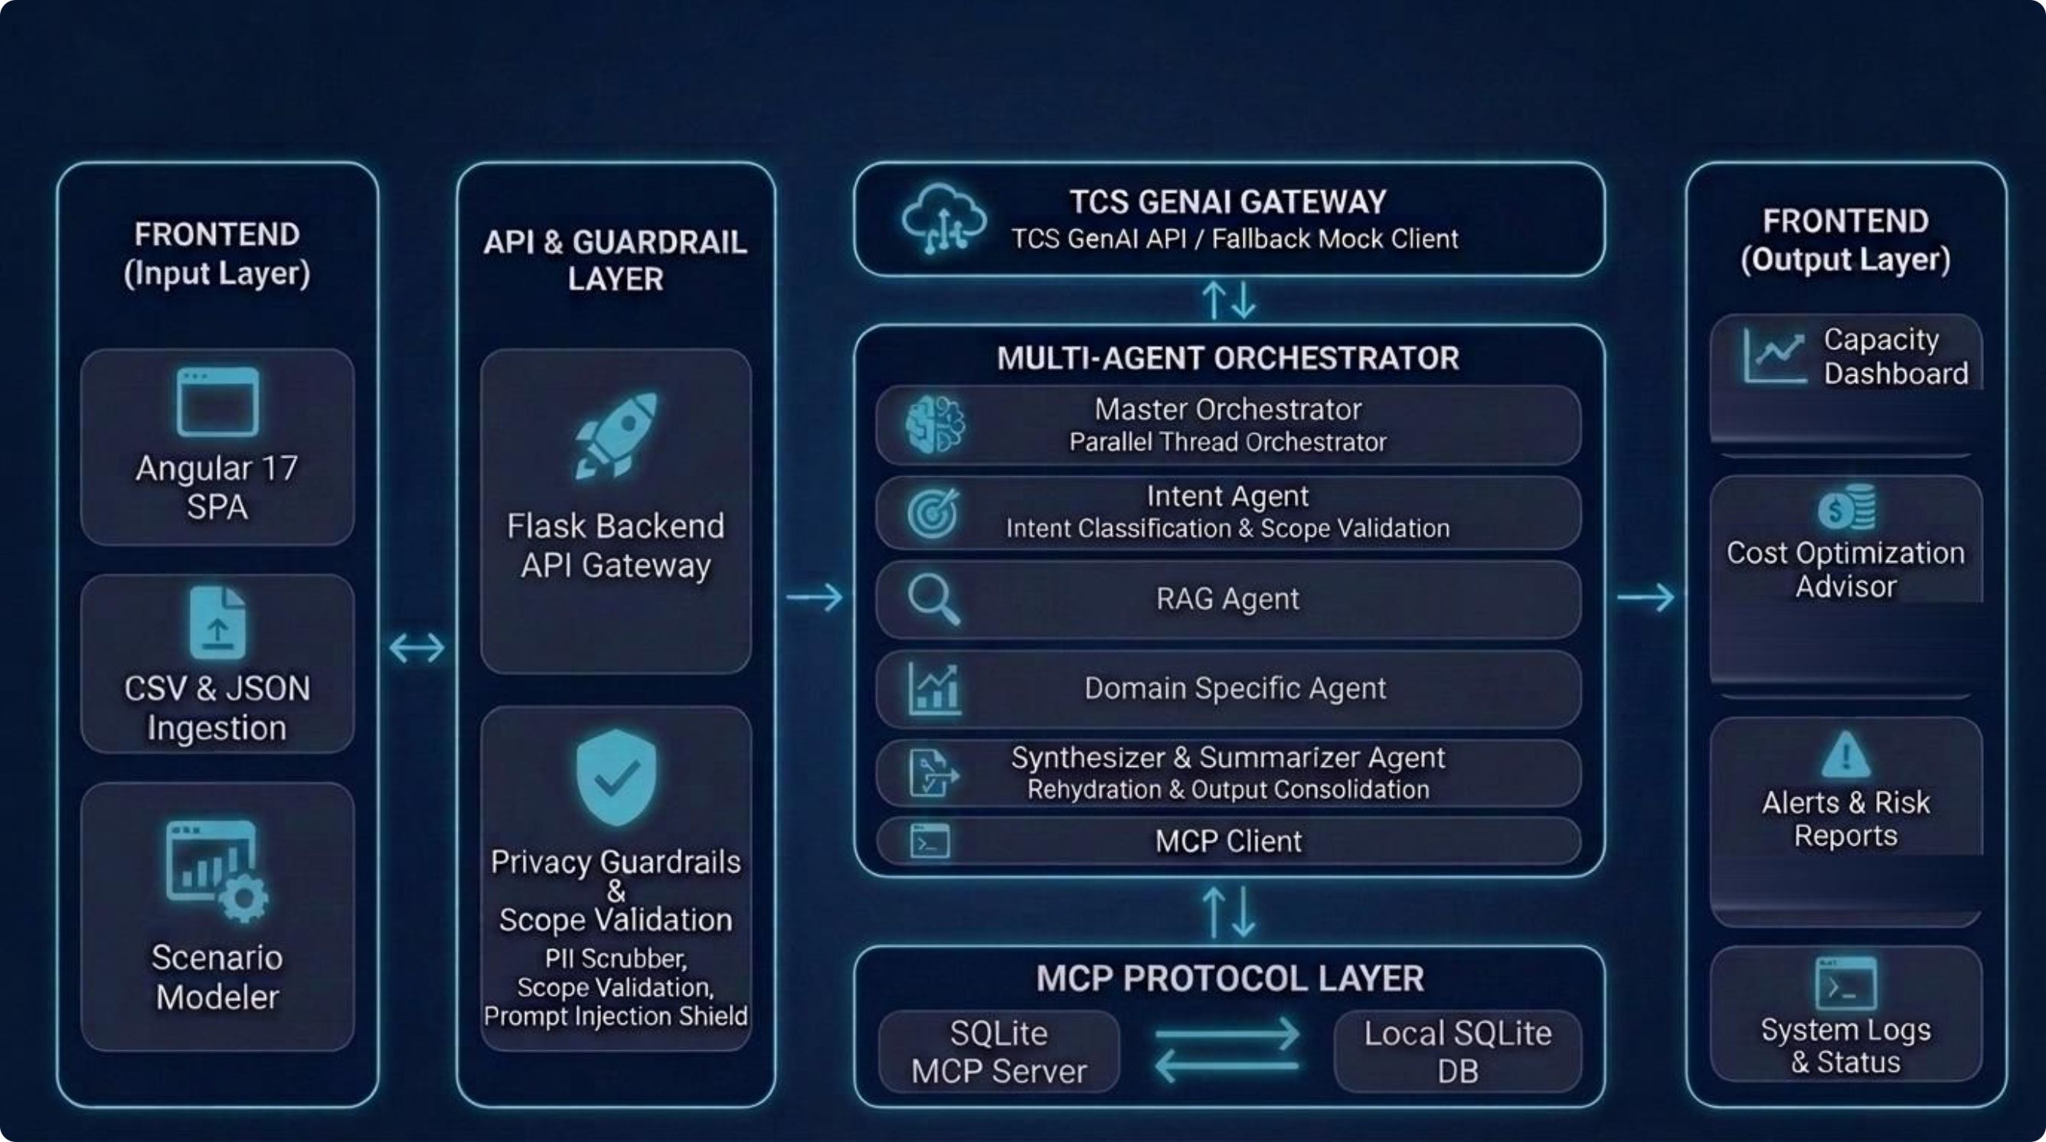
Architecture Diagram

Slide 4
Thank You

